Slide 1
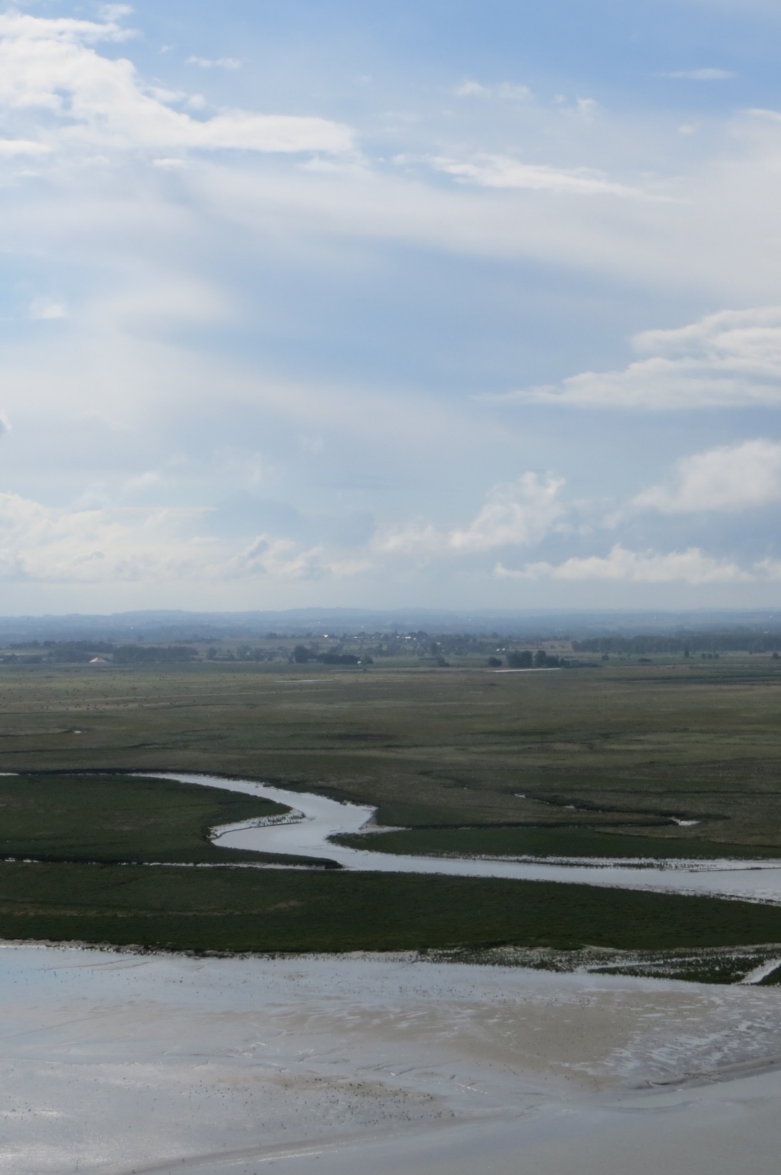
Consultancy for Policy Review and Plan Development
Fifth Convention on Wetlands Strategic Plan
SP5 Consultants
Rob McInnes
Nick Davidson
Priyanie Amerasinghe
Matthew Simpson
Rebecca Woodward
Christine Prietto
Luisa Ricaurte
5th Strategic Plan Working Group (SP5WG)
1 June 2023

Slide 2
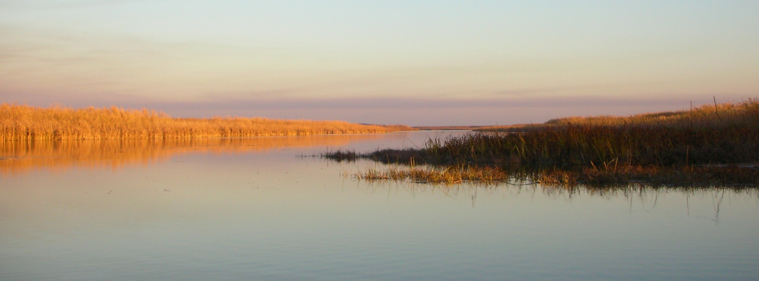
Engagement & Consultation Strategy
Draft circulated - Six questions for the Working Group
Overall principles and stakeholders
Consider and comment on the categorisation of stakeholders
Methods and approaches
Suggest approaches that would work in your country/region
Opportunities and synergies
Provide information on meetings, workshops, events, etc. in your country/region
Identify additional stakeholders
How can WG members help with implementing different approaches
Identify organisations that can assist with facilitation (language)

Slide 3
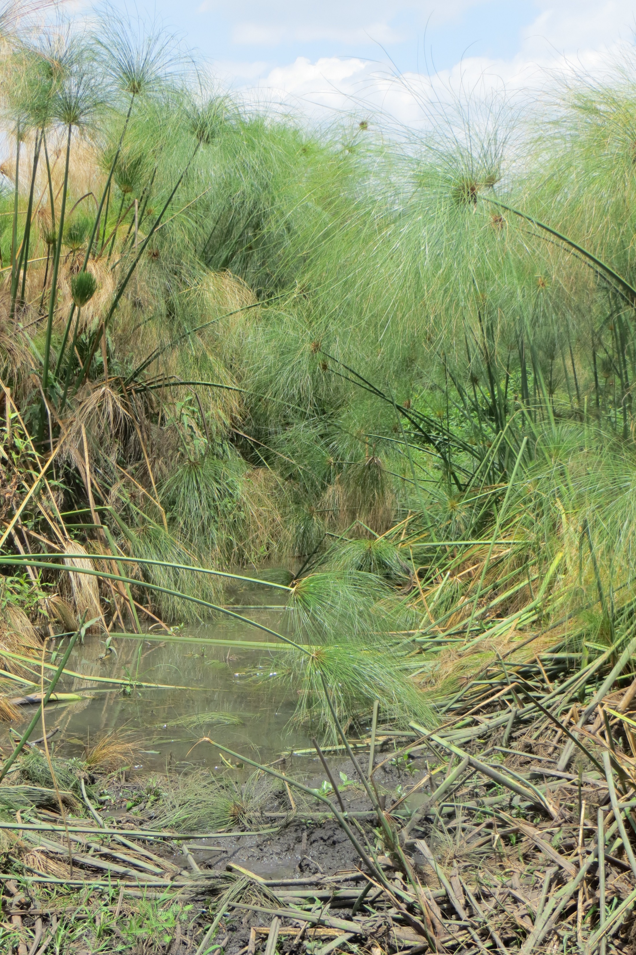
Feedback
Engagement & Consultation Strategy
Reviewed and incorporated comments received
Revised draft strategy circulated
Seeking feedback on:
Facilitation groups and their roles
Stakeholders / partners
Approaches and activities
Timeline
Feeding back

Slide 4
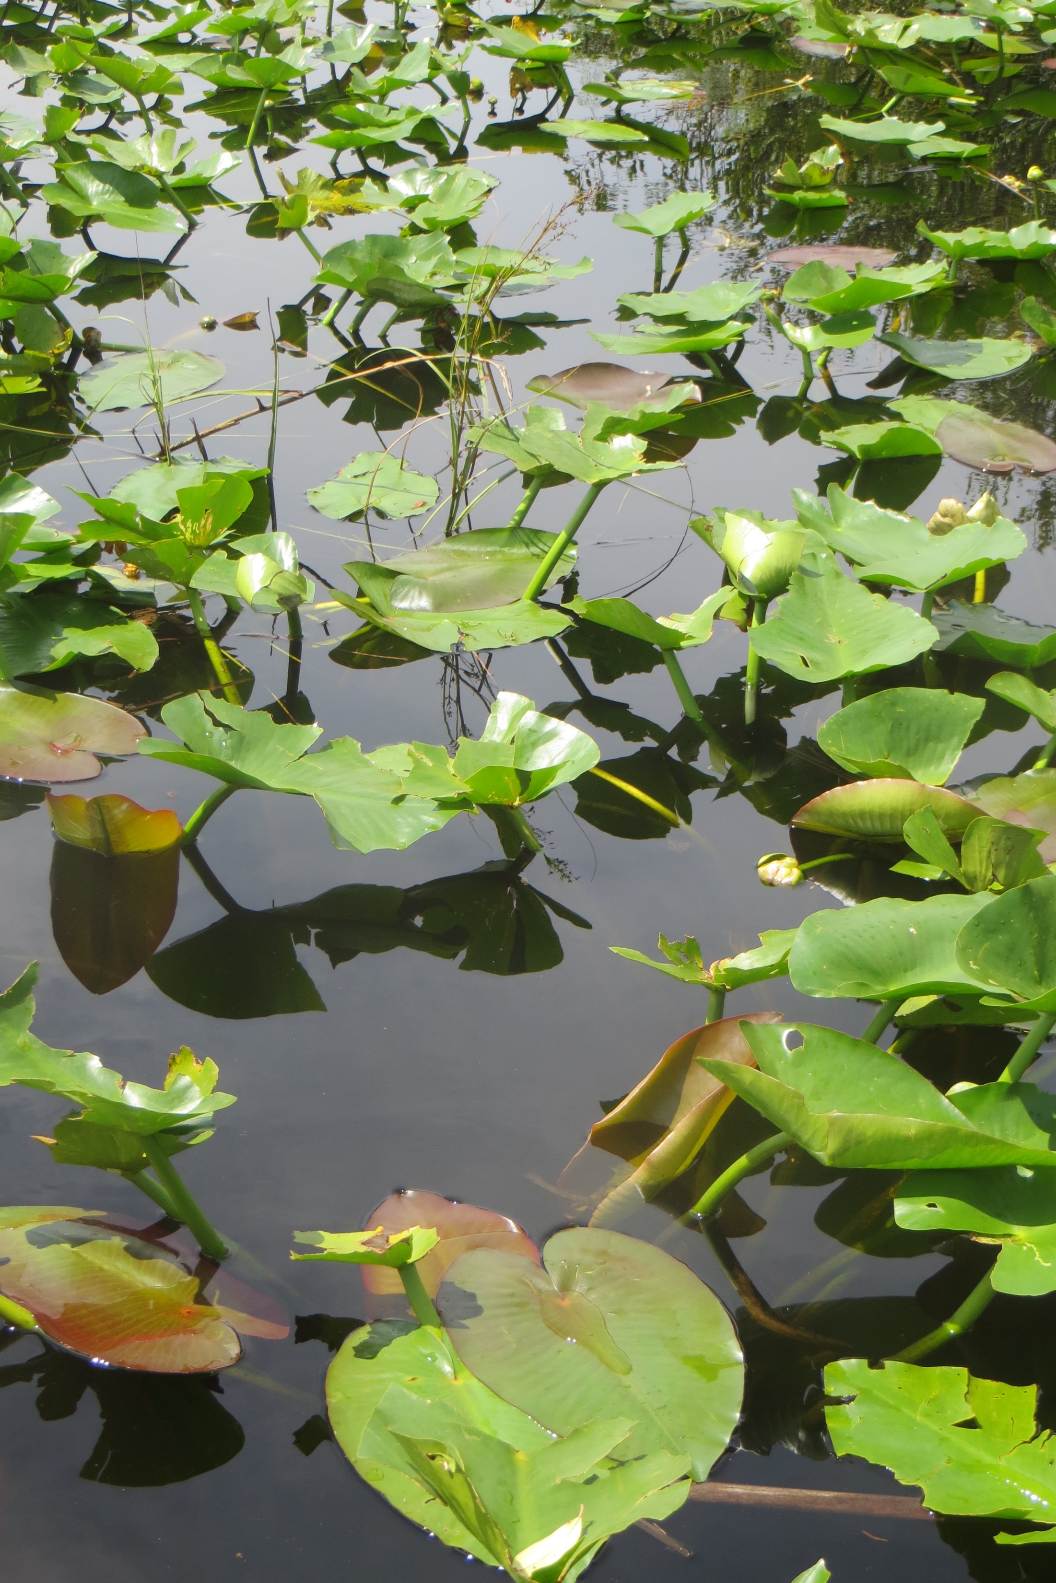
Workplan
Engagement & Consultation Strategy – Facilitation Groups
Contracting Parties through their NFPs, CEPA NFPs and STRP NFPs (including the SP5WG)
The Convention Secretariat
IOPS both at global and regional levels
RRIs and RRCs
Other observers with formal links to the Convention
5SP Consultants

Slide 5
Workplan
Engagement & Consultation Strategy – Facilitation Groups
The objectives of all the activities in the Workplan are:
Raise awareness of the SP5 development process
Gather information and intelligence to understand the challenges, opportunities and solutions for the wise use of wetlands
Collaborate inclusively across all partners to build a SP focused on those challenges, opportunities and solutions

